Slide 1
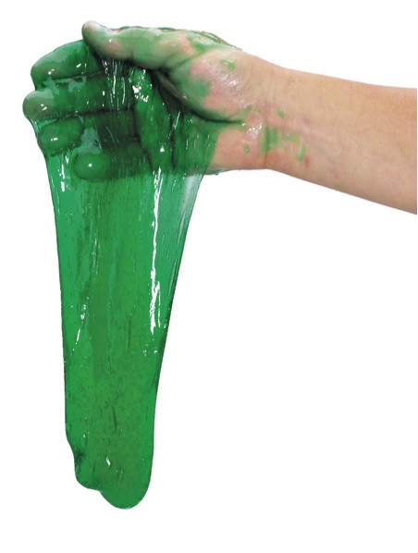
Time for Slime!
Making a cross-linked polymer

Slide 2
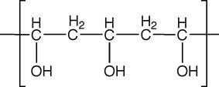
Make a polymer!
Use polyvinyl alcohol (PVA)
This is a repeating monomer of vinyl alcohol

Slide 3
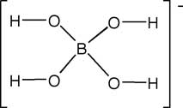
Add a few drops of boric acid solution
This acts as a cross-linker
Formula is Na₂B₄O₇ + 10H₂O
Boric acid forms borate ion in water:

Slide 4
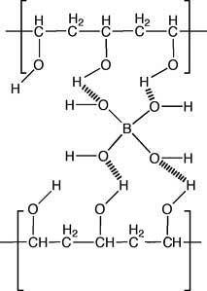
Mix together, and…….
Borate ion forms cross-links with the OH in PVA

Slide 5
Play with the slime and answer these:
1. List 3 physical characteristics of your polymer.
Roll some of the mixture up into a ball and set it on the table. What does it do?
What happens to it when it is slowly pulled?
How does it react when it is sharply pulled?
5. Does it bounce? Does it stretch? Can it shatter?
6. A fluid is anything that flows (air, liquids, etc.) Is this polymer a fluid? Why/why not?
7. Did you make a thermoplastic polymer or a thermoset polymer? How do you know?
8. Has a physical or chemical change occurred? Explain…..

