Slide 1
The Tools of Astronomy
How astronomers study space

Slide 2
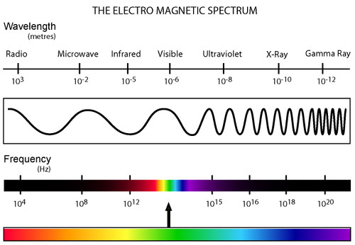
Electromagnetic Radiation (EMR)
Light can travel through empty space
All EMR travels at the speed of light→ 3 x 10⁸ m/sec
Astronomers study different types of EMR

Slide 3
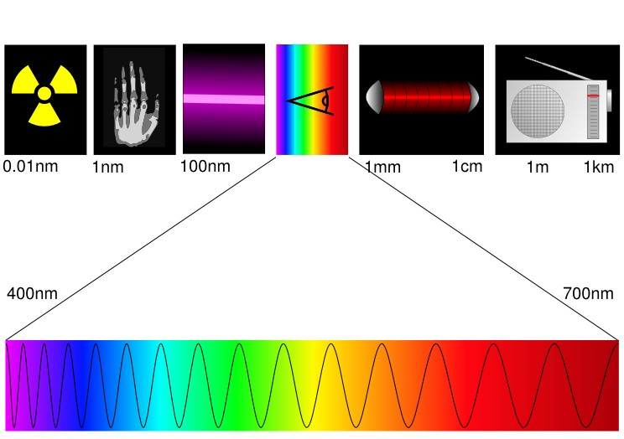
EMR continued
Different types of EMR are classified according to wavelength and frequency
Wavelength (λ)- distance between 2 peaks
Frequency (f)- # of waves occurring per second
Look at the diagram below- which color has the longest wavelength? (red) Shortest wavelength? (violet)
700 nm
400 nm

Slide 4
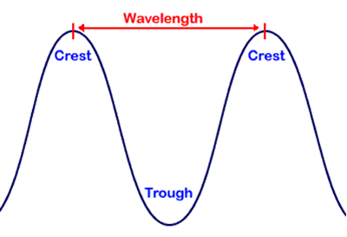
Wave basics
Draw a wave with 4 cycles per second: [ ]
Draw a wave with 10 cycles per second: [ ]
Which wave has the shorter wavelength?
Which wave has the longer wavelength?

Slide 5
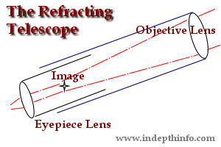
Telescopes: Refractors
Astronomers use two main types of telescopes to gather and study visible light: refractors and reflectors
REFRACTORS
Use at least two convex lenses to magnify an image

Slide 6
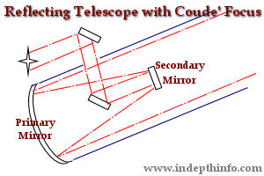
Telescopes: Reflectors
Use large convex mirrors to magnify an image
Most telescopes are reflectors

Slide 7
Telescopes
Mirror Radius | Light-gathering power
1 | 1 pi
2 | 4 pi
4 | 16 pi
8 | 64 pi
16 | ??
Objective lens or
mirror gathers light
Eyepiece lens
focuses light
Light gathering power
of the lens is related
to the size of the lens
– inverse square law
A = π r²
Double the radius and light gathering power increases 4x

Slide 8
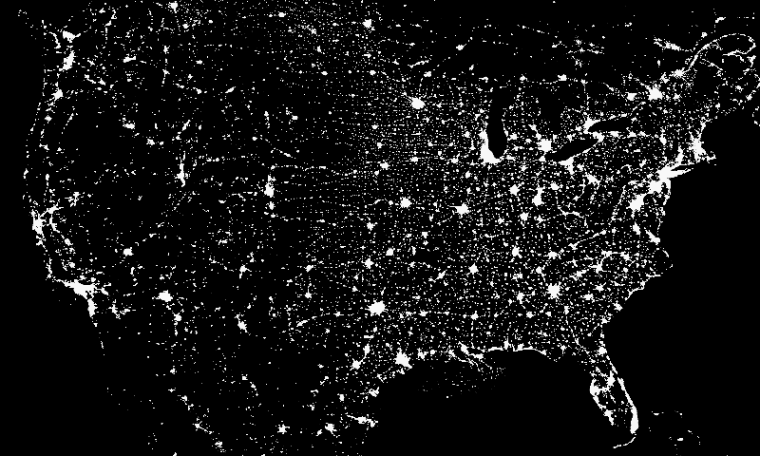
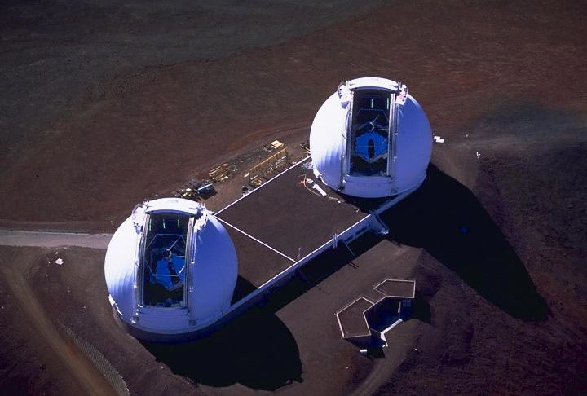
Most major observatories are located in remote, high
elevation locations in order to minimize light and
atmospheric interference

Slide 9
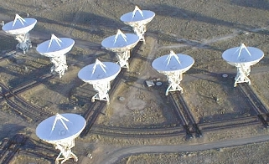
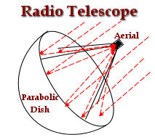
Radio Telescopes
Used to study radio waves (not visible light)
Use the same principle as radar
Can be very large
Satellite dishes are kind of like a radio telescope
Very Large Array in New Mexico

Slide 10
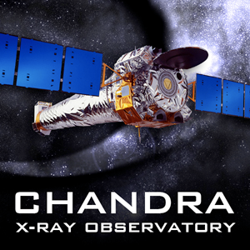
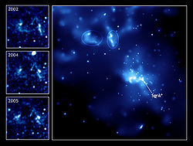
Chandra X-Ray Observatory
Unmanned satellite launched in 1999
Located outside of Earth’s atmosphere
Studies X-ray emissions from supernovas, black holes, neutron stars, etc.
Sagittarius A- supermassive black hole at center of Milky Way

Slide 11
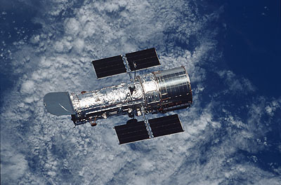
Hubble Space Telescope
Located outside of Earth’s atmosphere (about 350 miles or 589 Km above surface), so it can “see” more
Orbits Earth once every 97 minutes
Can detect UV, visible and infrared forms of EMR
Solar-powered
http://blogs.nature.com/news/thegreatbeyond/hubble.jpg

Slide 12
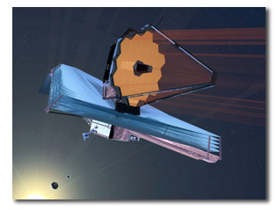
James Webb Telescope
Successor to Hubble
Will observe infrared light from faint and very distant objects
Will be much further away from Earth (about 1.5 million km) than Hubble
Launch during 2014?

