Slide 1
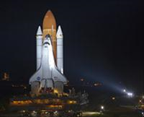
HOW BIG AND HOW FAR AWAY?
Space Shuttle Endeavor
5/16/11 http://tinyurl.com/6agyuhm
A MINI QUIZ

Slide 2
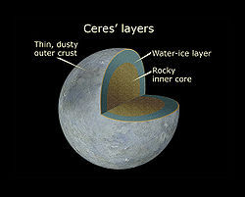
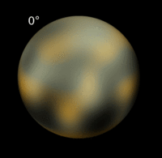
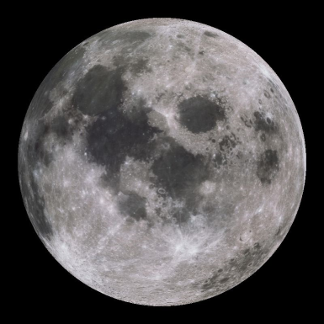
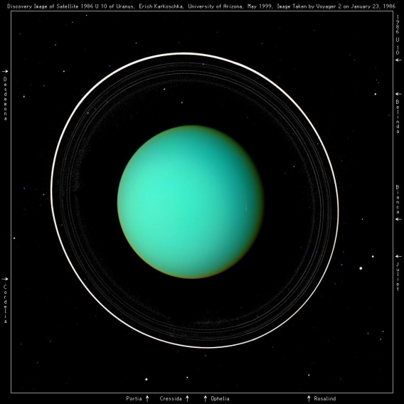
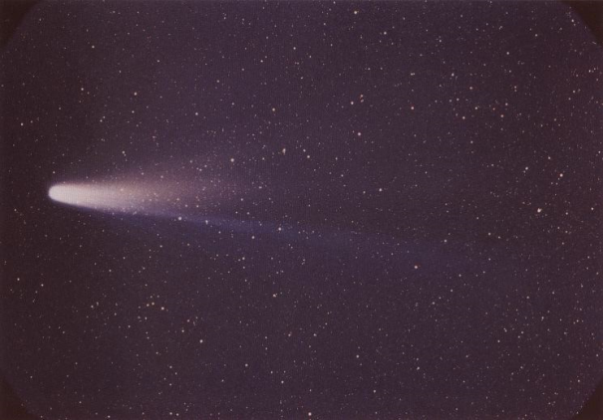
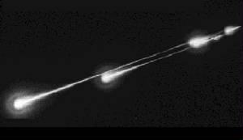
Put in order from smallest to largest
Asteroid
Pluto
Moon
Comet
Uranus
Meteor
Notes:
Meteoroids range in size from sand grains to boulders. Comets can be several miles in diameter. Asteroids can range from boulder sized to 100s of miles (Ceres). Pluto is 2360 km in diameter. Our Moon is 3476 km in diameter. Uranus is 51,118 km in diameter.

Slide 3
Now put them in order from closest to farthest
Asteroid
Pluto
Moon
Comet in Oort Cloud
Uranus
Meteor
Notes:
Tell the students to think of overall distance (including perihelion and aphelion). Meteor is closest because it burns up in our atmosphere. Next is Moon (384,000 km away). Next farthest is Ceres (2.8 AU from Sun). Next is Uranus (50 AU). Next is Pluto (102 AU). Last is the Oort Cloud (outside of Pluto).

Slide 4
Now… Match the object with its best description
1. asteroid belt a. Halley
2. Kuiper Belt b. Venus
3. Oort Cloud c. Pluto
4. terrestrial d. Uranus
5. Jovian e. Ceres
Notes:
1. E 2. C 3. A 4. B 5. D

