Slide 1
Fact or Not?
Mrs. Nork presents:

Slide 2
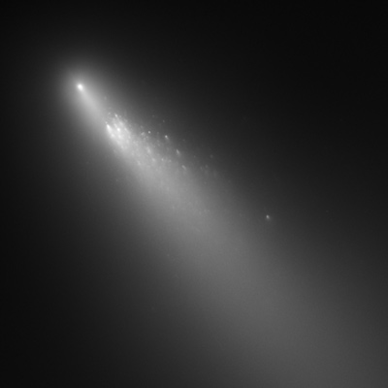
Fact or Not?
The tail of a comet always travels behind it as it moves.
Notes:
No. The tail always points away from the sun bc it is caused by the solar wind.

Slide 3
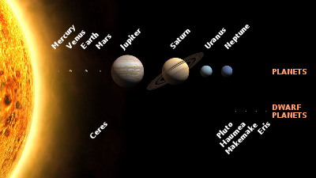
Fact or Not?
The terrestrial (inner) planets have a slower period of revolution because they have smaller orbits and less distance to cover.
Notes:
False. Inner planets travel faster due to Kepler’s 2nd Law (equal area)

Slide 4
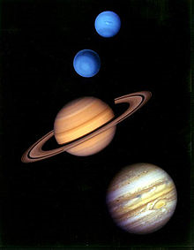
Fact or Not?
All of the planets have solid surfaces.
Notes:
No. Only the terrestrial planets do. The Jovian planets are gaseous.

Slide 5
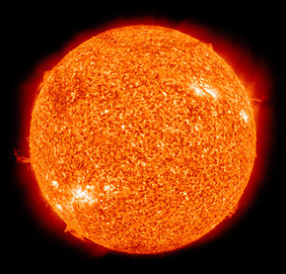
Fact or Not?
The sun rotates like the planets do.
Notes:
True (sort of). The equator takes 25 days to rotate and the poles take 35 days.

Slide 6
Fact or Not?
All of the gas giants have rings
Notes:
True!

Slide 7
Fact or Not?
The following are all members/parts of our solar system:
-planets, asteroids, Oort cloud , sun, Kuiper Belt, meteors, Milky Way.
Notes:
False. Everything is EXCEPT for Milky Way (our galaxy).

Slide 8
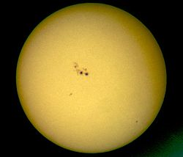
Fact or Not?
The next sunspot maximum is predicted to occur in 2012.

Slide 9
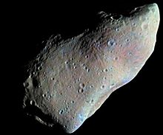
Fact or Not?
The Asteroid Belt is located between Mars and Earth.
Notes:
False! Mars and Jupiter

Slide 10
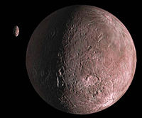
Fact or Not?
Members of the Kuiper Belt include Quaoar, Pluto, Eris and Ceres.
Notes:
False! Ceres is an asteroid☺

Slide 11
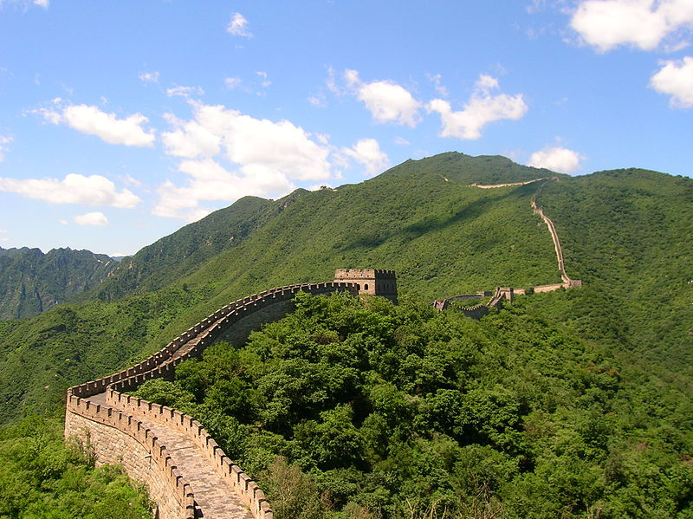
Fact or Not?
The Great Wall of China is the only man-made object that can be seen from the Moon.
Notes:
NOPE!

