Slide 1
The Carbon Cycle
With labels:
http://www.youtube.com/watch?v=U3SZKJVKRxQ
Unlabeled: http://www.youtube.com/watch?v=OByqdUhWERk&feature=related
Watch each video and describe in your own words three directions that carbon moves.
For example: Carbon moves from __________ to ________ when ___________ happens.

Slide 2
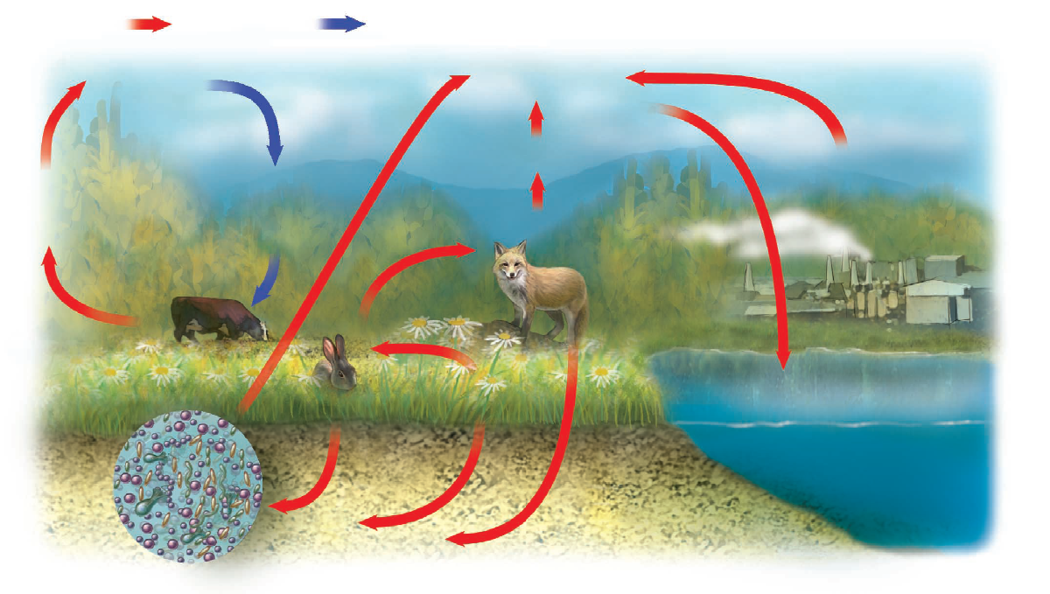

Slide 3
