Slide 1
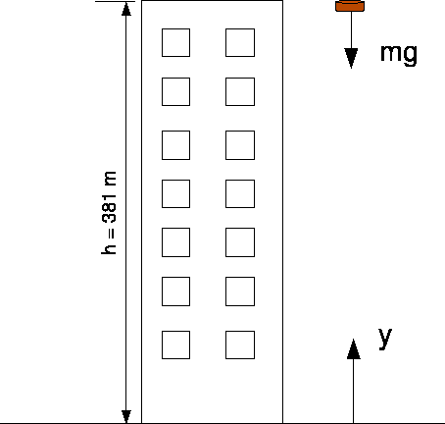
can you kill someone by dropping a penny off of the empire state building?
Kinetic and Potential Energy

Slide 2
Potential energy = mgh
Calculate the potential energy (PE) of a 3 gram penny perched 390 meters up on the ledge of the Empire State Building.
Hints:
Use “”10” for the gravity constant
Convert the mass to kg

Slide 3
Kinetic energy = .5mv²
Calculate the kinetic energy (KE) of a 3 gram penny falling at terminal velocity (88 m/sec).
Hint:
Convert g to kg!

Slide 4
Are These Potential or Kinetic (or both)? You tell me!
1. pile of coal that will be used for fuel
2. flag blowing in the wind
3. shoebox stored on top of closet shelf
4. unlit firecracker
5. hammer held above nail
6. rolling marble
7. swinging pendulum
8. glucose stored in a plant
9. bouncing on a trampoline

