Slide 1
The Tools of Astronomy
How astronomers study space

Slide 2
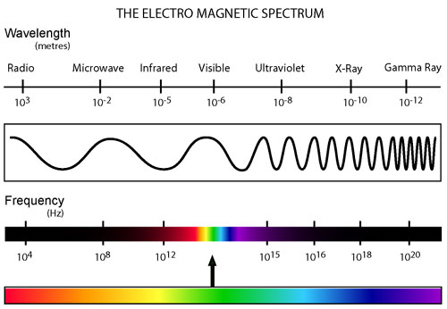
Electromagnetic Radiation (EMR)
Light can travel through _____________________
All EMR travels at the speed of light→ _______ m/sec
Astronomers study different types of EMR

Slide 3
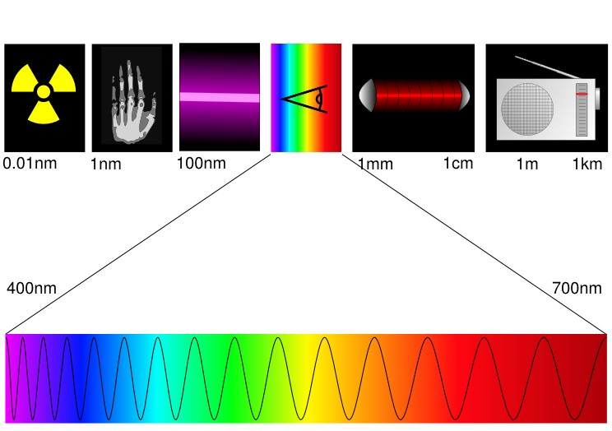
EMR continued
Different types of EMR are classified according to ______________and ____________
Wavelength (λ)- distance between _______________
Frequency (f)- _______________occurring per second
Look at the diagram below- which color has the longest wavelength? (_____) Shortest wavelength? (_____)
700 nm
400 nm

Slide 4
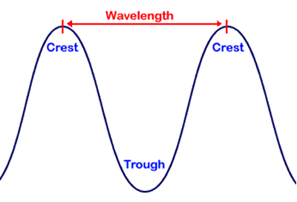
Wave basics
Draw a wave with 4 cycles per second: [ ]
Draw a wave with 10 cycles per second: [ ]
Which wave has the shorter wavelength?
Which wave has the longer wavelength?

Slide 5
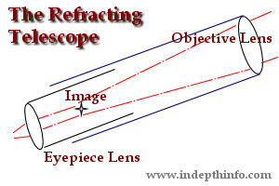
Telescopes: Refractors
Astronomers use two main types of telescopes to gather and study visible light: refractors and reflectors
REFRACTORS
Use at least two _________________ to magnify an image

Slide 6
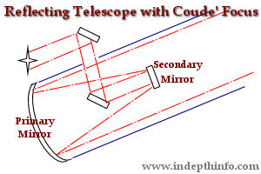
Telescopes: Reflectors
Use large _________________ to magnify an image
Most telescopes are ______________

Slide 7
Telescopes
Mirror Radius | Light-gathering power
1 | 1 pi
2 | 4 pi
4 | 16 pi
8 | 64 pi
16 | ??
Objective lens or
mirror gathers light
Eyepiece lens
focuses light
Light gathering power
of the lens is related
to the size of the lens
* inverse square law
________________
Double the radius and light gathering power increases __________

Slide 8
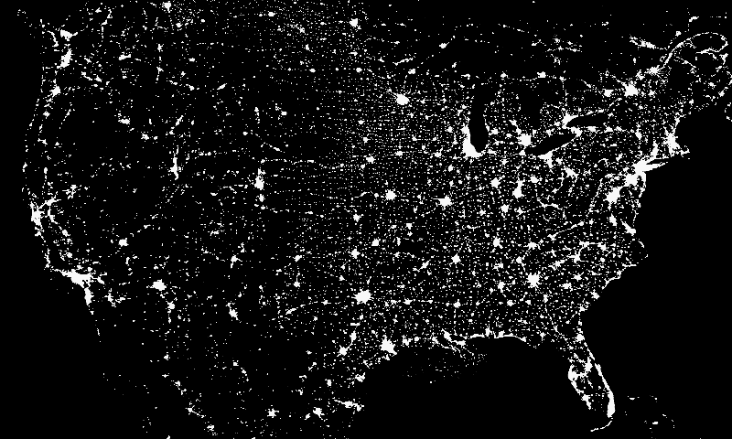
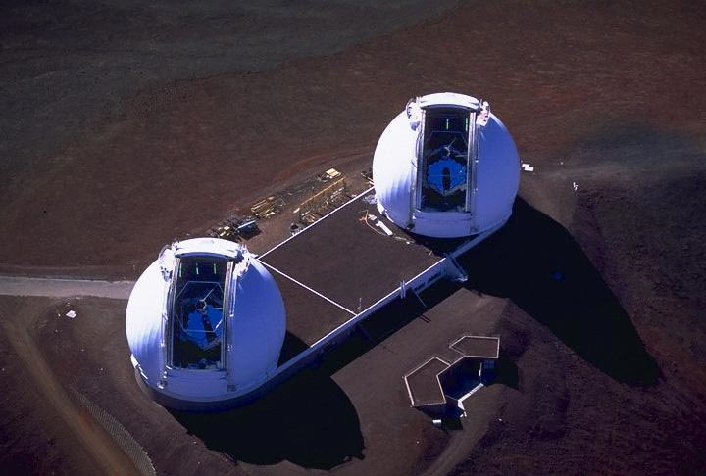
Most major observatories are located in ________, _______ elevation locations in order to minimize light and atmospheric _______________.

Slide 9
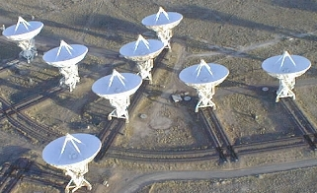
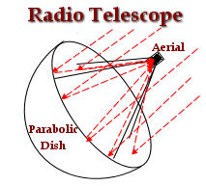
Radio Telescopes
Used to study __________ waves (not visible light)
Use the same principle as radar
Can be very large
___________ dishes are kind of like a radio telescope
Very Large Array in New Mexico

Slide 10
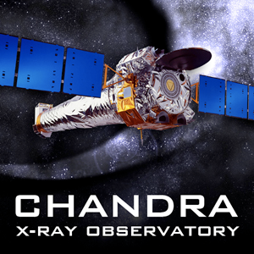
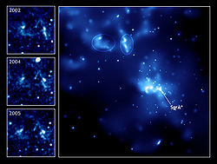
Chandra X-Ray Observatory
Unmanned satellite launched in 1999
Located __________ of Earth’s atmosphere
Studies ________ emissions from supernovas, black holes, neutron stars, etc.
Sagittarius A- supermassive black hole at center of Milky Way

Slide 11
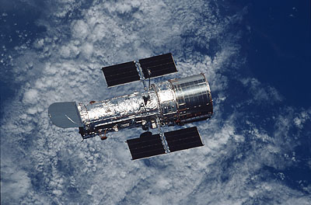
Hubble Space Telescope
Located outside of Earth’s ____________ (about 350 miles or 589 Km above surface), so it can “see” more
Orbits Earth once every ____ minutes
Can detect ____, visible and__________ forms of EMR
________-powered
http://blogs.nature.com/news/thegreatbeyond/hubble.jpg

Slide 12
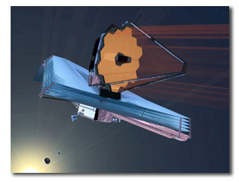
James Webb Telescope
Successor to ______________
Will observe ___________ light from faint and very distant objects
Will be much further away from Earth (about 1.5 million km) than Hubble
Launch during 2018

