Slide 1
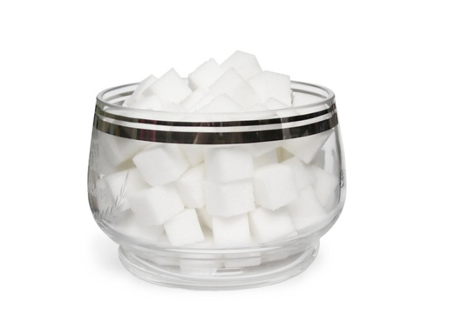
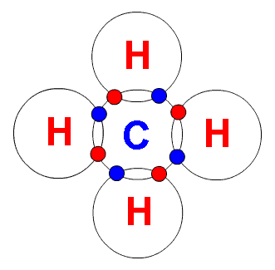
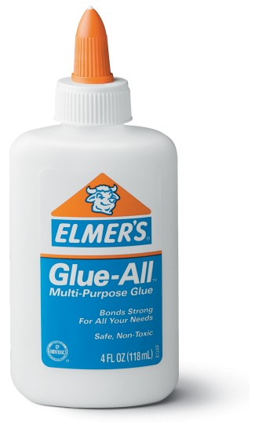
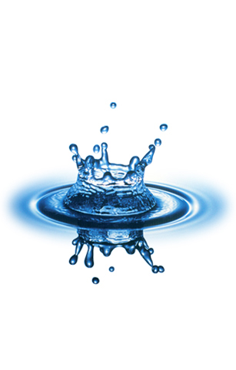
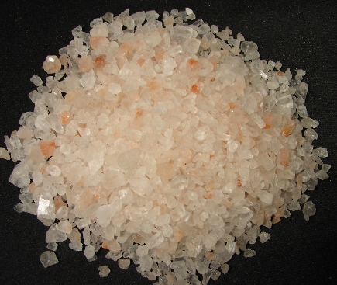
#1_________________
I am a pure substance
Made of 2 or more elements bonded together
Examples include glue, water, table salt, sugar, methane

Slide 2
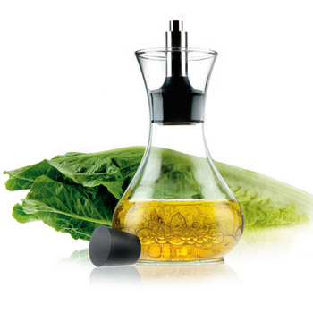
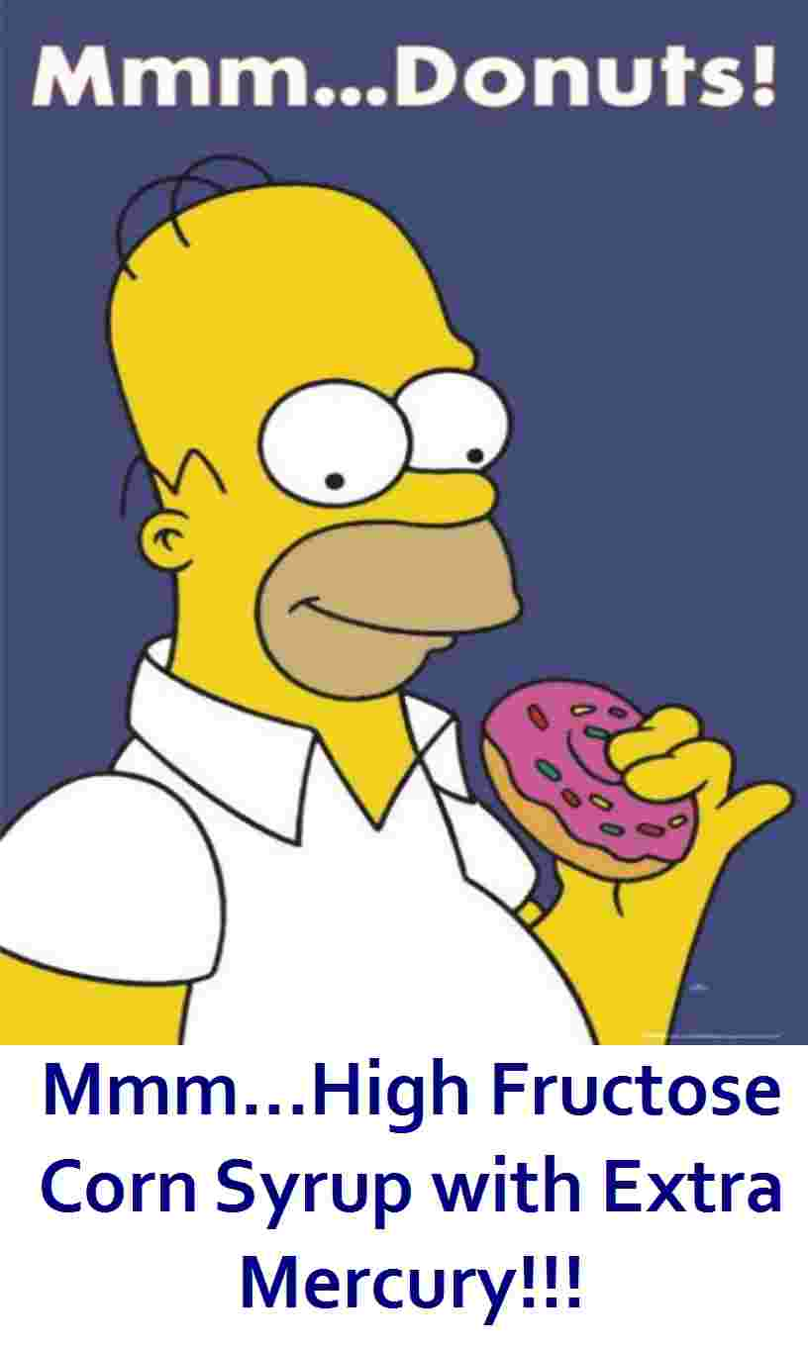
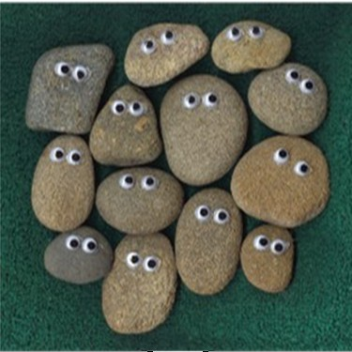
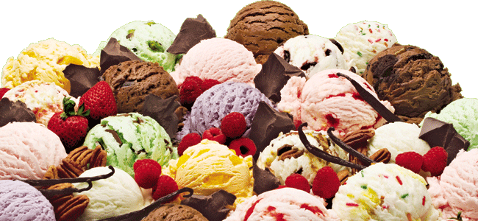
#2________________
I’m a combination of 2 or more substances that are NOT chemically combined
I may not appear the same throughout, and my larger particles are easier to separate
Examples include salad dressing, rocks, ice cream, donuts and a bucket of toys

Slide 3
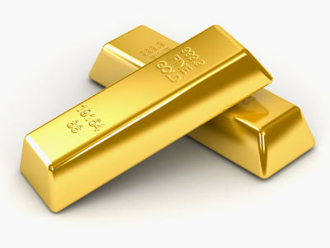
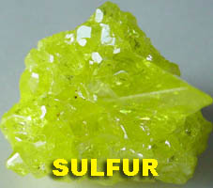
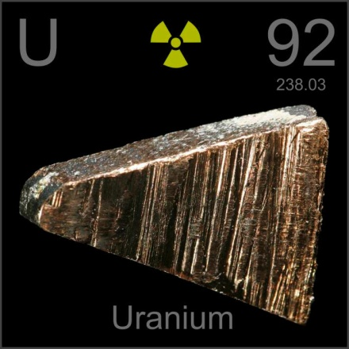
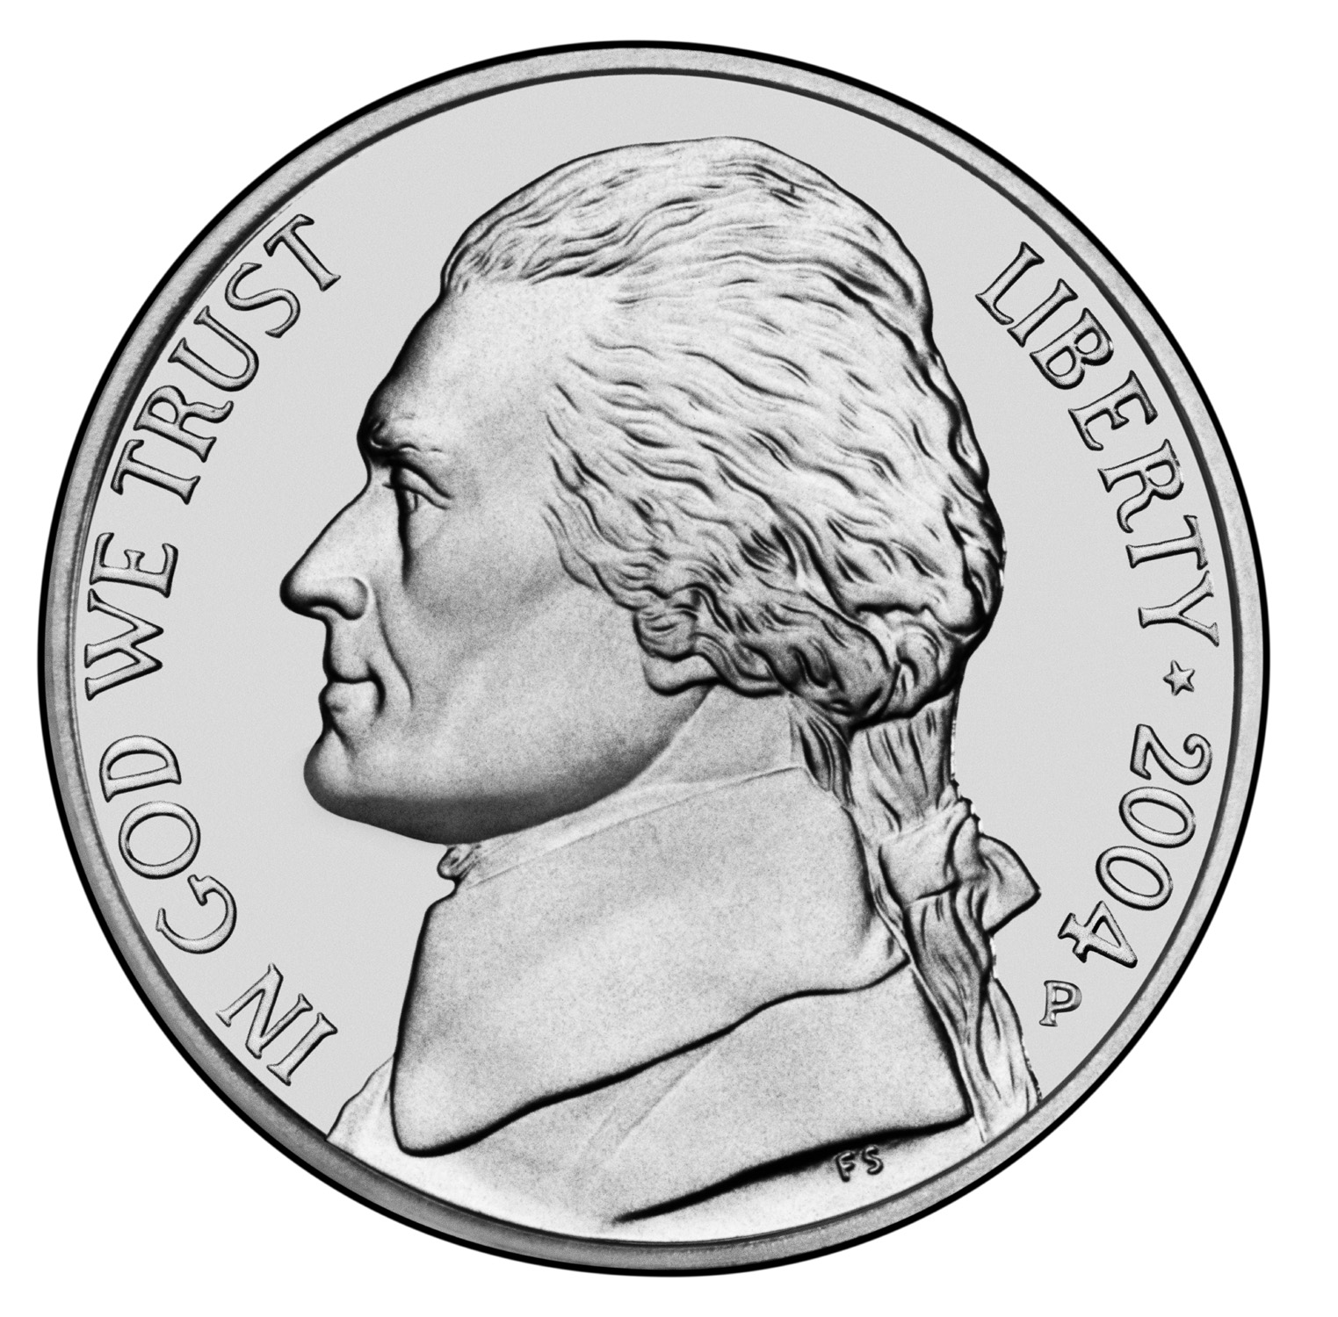
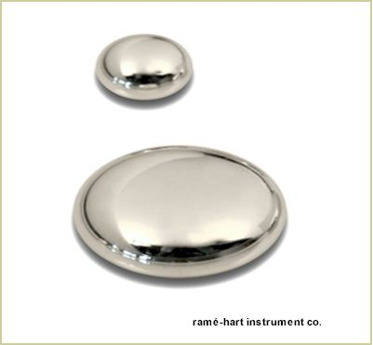
#3______________
I am composed of only one type of atom
I am found on the Periodic Table arranged by increasing atomic #
The atomic # = the amount of protons I have
Examples include U, Ni, Au, Hg, and S

Slide 4
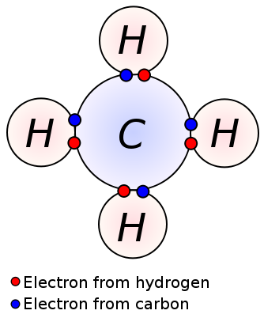
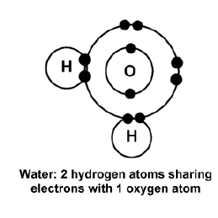
#4______________
I am a bond that forms between nonmetals
This type of bond involves sharing pairs of electrons
Both nonmetals need 8 electrons to be “happy” (unless you’re Hydrogen, of course!)
I form mostly liquids and gases
Methane CH₄

Slide 5
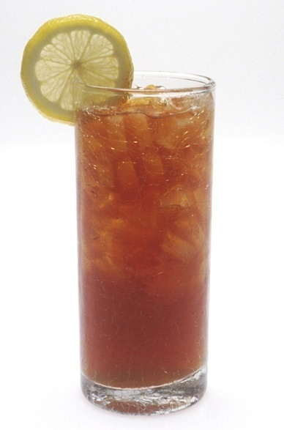
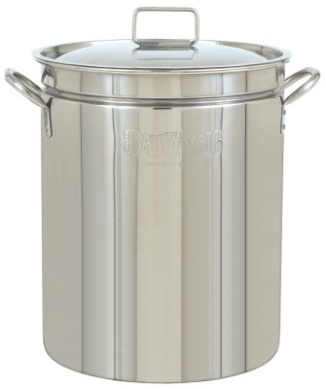
#5_______________
I am a combination of 2 or more substances that are only physically (NOT chemically) combined
I have smaller particles
I appear to have the same composition throughout
Examples are air, stainless steel, sweetened iced tea, smoke

Slide 6
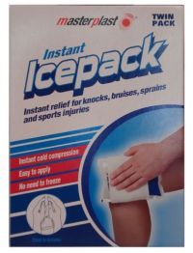
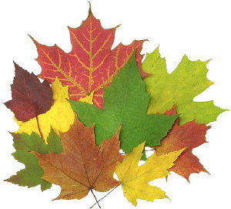
#6__________________
Examples include: burning a marshmallow, colorful foliage, breaking an ice pack

Slide 7
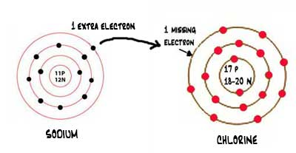
#7__________________
I am a bond that forms between a metal and a nonmetal
My metal transfers (loses) electrons to my nonmetal

Slide 8
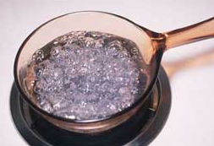
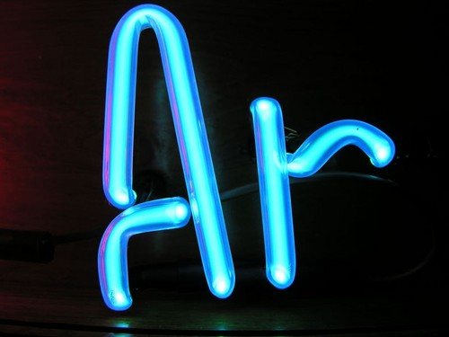
#8__________________
Examples include: ripping paper, turning on a light, boiling water

Slide 9
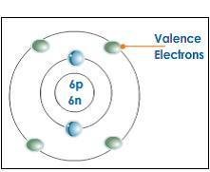
#9__________________
I am the electrons in the outermost level
I play a very important role in bonding
Outer electrons

