Slide 1
The Doppler Effect

Slide 2
Doppler Effect
Shift in _________(high to low) due to the compression of ____ (or _____) waves in front of a moving object and the ________ of the light (or sound) waves behind the moving object

Slide 3
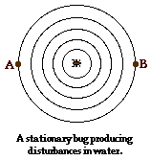
Stationary object
Same wavelength and therefore same frequency at A&B

Slide 4
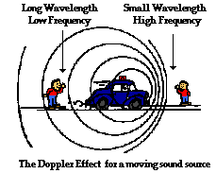
Moving object

Slide 5
Doppler Shift in Astronomy….
If the object is coming towards you, the _____is shifted toward _______ wavelengths, _____shifted.
If the object is _________ from you, the light is shifted toward _______ wavelengths, ______shifted.
The amount of shift is bigger if the emitting object is moving faster.

