Slide 1
What Type of Star am I?
I am a contracting cloud heating up by friction- I’m not really a star yet
I may be in this stage for millions of years

Slide 2
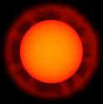
What am I?
I am a relatively old star whose diameter has swollen enormously.
My temperature has also cooled and I’m very luminous.
My contracting hydrogen core has turned to helium and eventually will turn to carbon

Slide 3
What Type of Star am I?
I am a small, very dense, dim, hot star near the end of my life.
I am made mostly of carbon.
I formed from the remains of a red giant star
I am about the size of the Earth (but much heavier

Slide 4
What type of star am I?
I’m as big as a star can get…I have many shells which fuse different elements- even Ni and Fe!
I will most likely go supernova and then maybe neutron star (or even black hole).
Stars like me (and our explosions) are the sources of all the heavy elements on your planet.

Slide 5
What am I?
I formed from a massive star (over 8x the mass of our sun)
Not even light can escape me

Slide 6
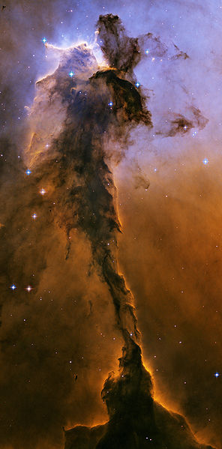
What am I?
I am an enormous cloud of gas and dust
I will start to contract and rotate.
I may give birth to millions of stars.

Slide 7
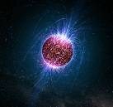
What Type of Star am I?
I am a very small, super-dense star
I am composed mostly of tightly-packed neutrons

Slide 8
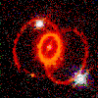
What am I?
I am a huge explosion that occurs at the end of a mid- to heavy-weight star's life
I releases a tremendous amount of energy, expelling the outer layers of the star and becoming extremely bright
What remains after me is a neutron star or a black hole

Slide 9
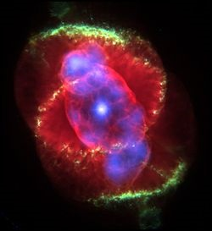
What am I?
I formed from a star that used up its hydrogen and helium fuel. The star wasn’t hot enough to fuse carbon, so it blew it outer layers and well, here I am!
I am just a shell of gas, but a
really pretty one ☺
Look carefully to see the
white dwarf in the center!

