Slide 1
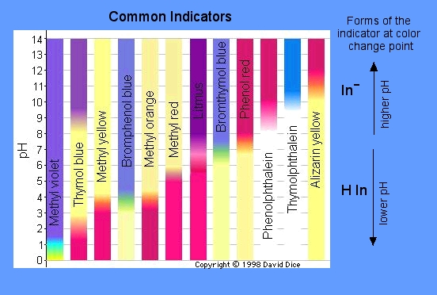
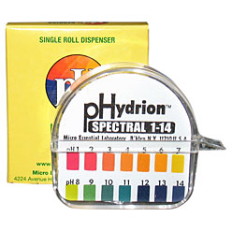
Reactions of acids and bases…

Slide 2
Neutralization…
Acid + Base → salt and water
Ex. HNO₃ + NaOH → NaNO₃ + H₂O
Which is the acid? Which is the base? How do you know?
How to best neutralize a strong acid spill?

Slide 3
Remember the pH scale…
Label strong acids, strong bases, weak acids,
weak bases, neutral substance

Slide 4
Reaction of metal with an acid…
Metal + acid → salt + hydrogen gas
Ex. Na + HCl → NaCl + H₂
Is the equation above balanced?
Demo of this (and don’t try this at home) metal and acid reaction

Slide 5
Reaction of metal with water…
Alkali metal + water → base + hydrogen gas
Ex. Li + H₂O → LiOH + H₂
Is the equation above balanced?
Why can’t I do this demo in class?
this is why...

