Slide 1
Name That Spectrum!
Ready, set, go!

Slide 2
#1 What is it?
Notes:
Blacklight

Slide 3
#2 What is it?
Notes:
Neon

Slide 4
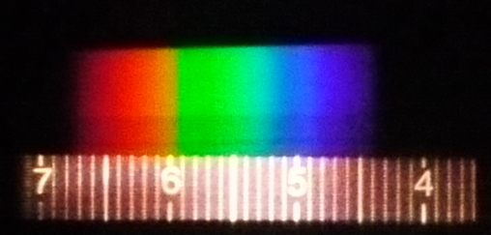
#3 What is it?
Notes:
Incandescent

Slide 5
#4 What is it?
Notes:
Hydrogen

Slide 6
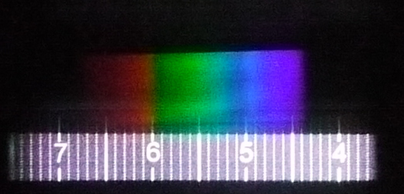
#5 What is it?
Notes:
Sunlight

Slide 7
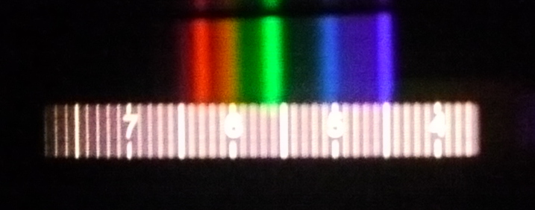
#6 What is it?
Notes:
Fluorescent

