Slide 1
Doppler Effect
Shift in frequency (high to low) due to the compression of light (or sound) waves in front of a moving object and the expansion of the light (or sound) waves behind the moving object

Slide 2
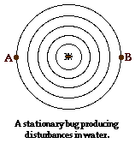
Stationary object
Same wavelength and therefore same frequency at A&B

Slide 3
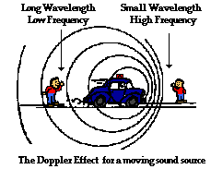
Moving object

Slide 4
Doppler Shift in Astronomy….
If the object is coming towards you, the light is shifted toward shorter wavelengths, blue shifted.
If the object is going away from you, the light is shifted toward longer wavelengths, red shifted.
The amount of shift is bigger if the emitting object is moving faster.

Slide 6
