Slide 1
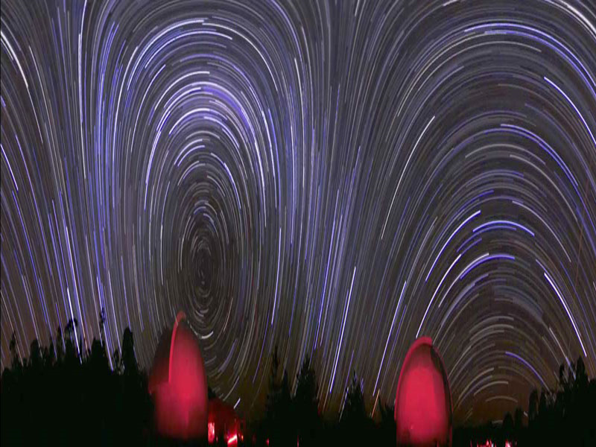
Measuring the Stars

Slide 2
How Do Astronomers Measure the Brightness of a Star?
Stars vary greatly in brightness
Early peoples observed bright stars and grouped them into constellations (88)
Ancient Greeks established classification system based on star brightness
Apparent magnitude- brightness of a star as viewed from Earth
A difference of 1 magnitude corresponds to a factor of 2.5 in brightness
The smaller (more negative) the #, the brighter the star

Slide 3
Examples of Apparent Magnitude
*REMEMBER- lower magnitude = brighter stars!!

Slide 4
Problem: Apparent Magnitudes only measure relative brightness!
1 light-year
10 light-years
Apparent magnitudes only tell us how bright stars appear to be, NOT how bright they actually are. Look at the above example:
-There are 2 stars that both shine with the exact same amount of light, BUT one of them is 10x further than the other
-The further one will send us 10² = 100x less light
-100x less light means the further star will be 5 magnitudes dimmer than the closer star

Slide 5
Solution #1: Astronomers Measure Absolute Magnitude
Absolute magnitude is the brightness an object would have if it were placed at a distance of 10 parsec (or 32 light-years); measures the inherent brightness of a star
More negative number = brighter star!
Star Apparent Mag. Absolute Mag.
Sun -26.74 4.83
Sirius -1.44 1.45
Arcturus -0.05 -0.31
Vega 0.03 0.58
Antares 1.00 -4.7

Slide 6
Solution #2: Astronomers Measure Luminosity
Luminosity- total amount of energy that a star radiates per second (watts)
Measured in units of solar luminosity
Examples:
Sun- luminosity of 1
Polaris (North Star)- luminosity of 2200
Proxima Centauri- luminosity of .000138

Slide 7
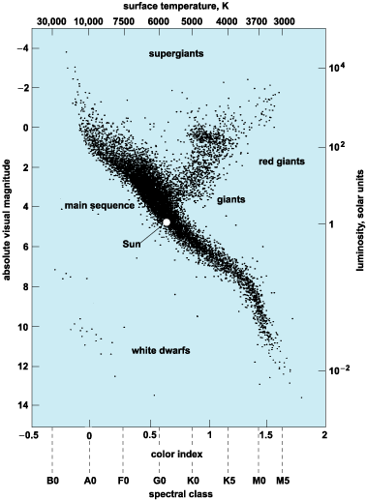
Hertzsprung-Russell Diagram
H-R diagram demonstrates the relationship between mass, luminosity and temperature
An H-R diagram plots the absolute mag on the vertical axis and temp (or spectral type) on the horizontal axis
Sometimes the y axis is luminosity

Slide 8
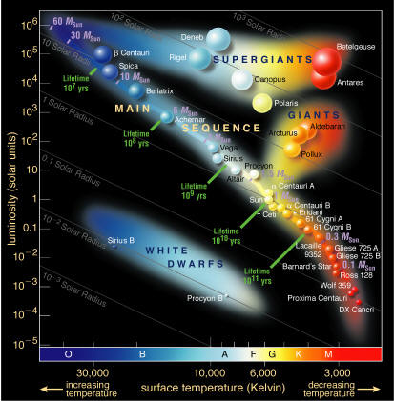
H-R Diagram
The main sequence, which runs diagonally from the upper left corner (hot, very luminous blue giants) to the lower right corner (cool, faint red dwarfs), represents about 90% of stars

Slide 9
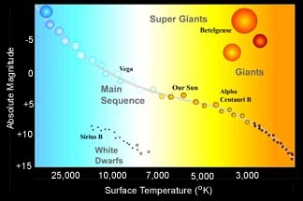
Remaining 10% of stars include:
red giants and supergiants- large, cool, luminous stars plotted at the upper right corner
white dwarfs- small, dim, hot stars in the lower left corner

Slide 10
Star Surface Temperature
Stars are classified into 7 main stellar spectra from “O” (hottest, bluest) to “M” (coolest, reddest)
The color of a star tells is its temperature!!
Our sun is a G5
(Stupid mnemonic: Oh Be A Fine Guy/Girl Kiss Me)

Slide 11
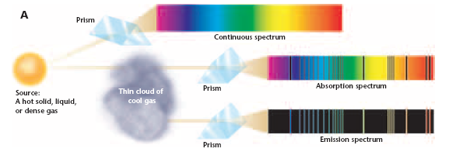
Star Composition
The spectra of light coming from stars can be used to determine what elements they are made of
73 % H, 25 % He, 2% other elements
Hotter stars have fewer spectral lines

Slide 12
Redshift/Blueshift
As a star moves towards or away from an observer, light is blueshifted or redshifted

Slide 13
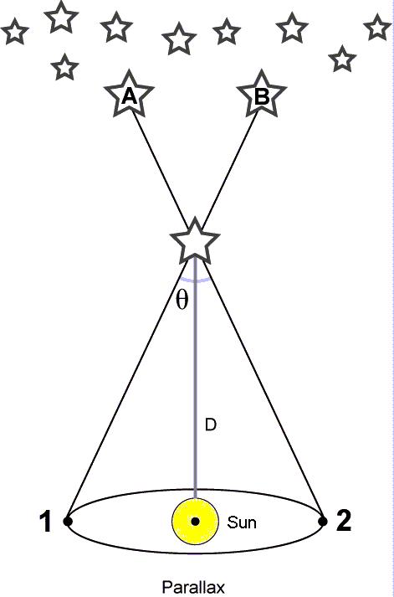
Measuring distances to nearby stars
Parallax – apparent shift in a star’s position caused by the motion of the observer
Nearby stars appear to shift back and forth relative to more distant stars as Earth moves around the Sun
The closer the star, the greater the shift
Parallax can be used to measure distances up to 500 parsec (1600 light years-LY)
1 parsec = 3.26 LY, or 31 trillion km

Slide 14
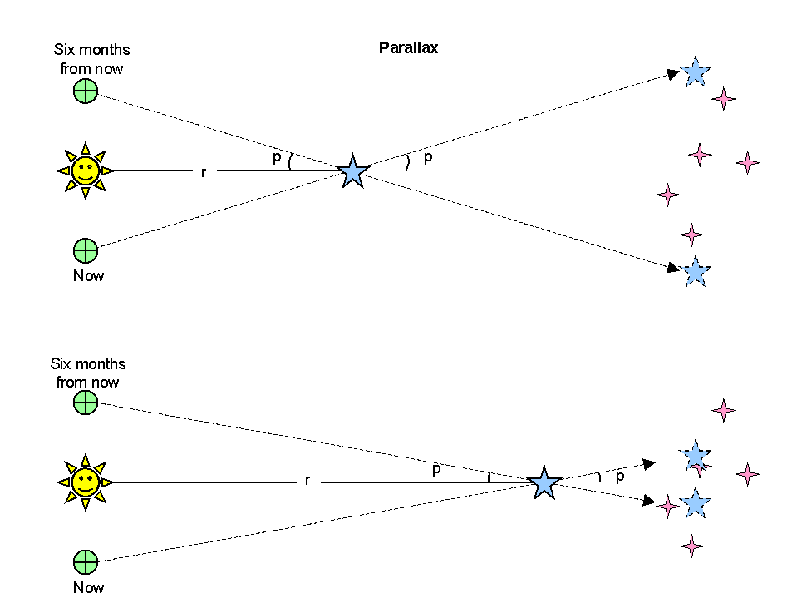
http://astronomy.nmsu.edu/aruiter/ASTRONOMY110/parallax.gif

