Slide 1
The Tools of Astronomy
How astronomers study space

Slide 2
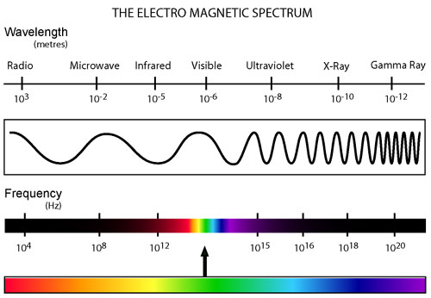
Electromagnetic Radiation (EMR)
Light can travel through empty space
All EMR travels at the speed of light→ 3 x 10⁸ m/sec
Astronomers study different types of EMR

Slide 3
Radiation
Tools of Astronomy
Electromagnetic radiation travels at the same speed and is classified by:
Wavelength (λ)- distance between 2 peaks
Frequency (f)- # of waves occurring per second

Slide 4
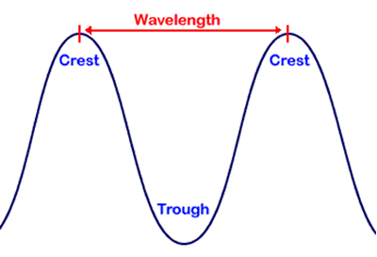
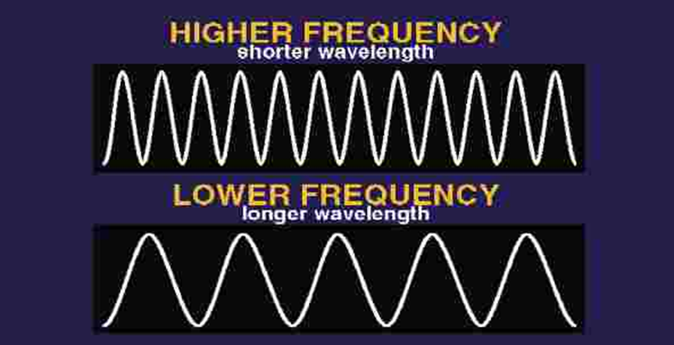
Wave basics

Slide 5
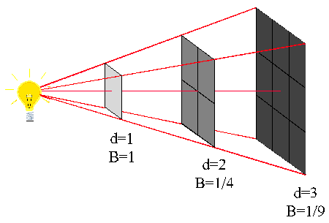
Propagation of Light
As you move away from a light source the light gets dimmer.
How much … depends on the Inverse Square Law
If we stand twice as far from a light we ¼ or 4x less light; and the light covers 4x the area.
Same light covers more area

Slide 6
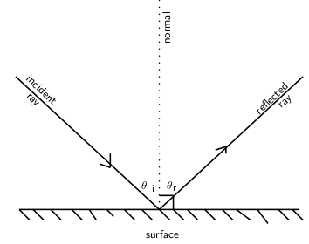
Refraction vs. Reflection
Refraction
Bending of light
Reflection
Bounce back of light

Slide 7
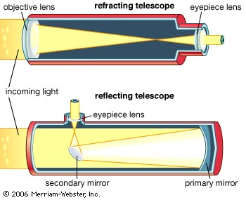
Telescopes
Tools of Astronomy

Slide 8
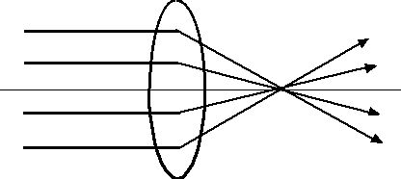
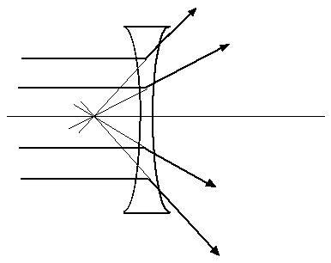
Convex Lens
Concave Lens

Slide 9
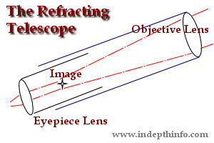
Telescopes: Refractors
Astronomers use two main types of telescopes to gather and study visible light: refractors and reflectors
REFRACTORS
Use at least two convex lenses to magnify an image
Reflectors make up the majority of telescopes that are in use today.
Most major observatories are located in remote, high elevation locations in order to minimize light and atmospheric interference.

Slide 10
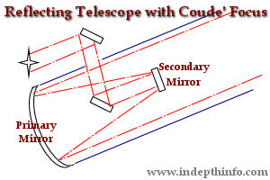
Telescopes: Reflectors
Use large convex mirrors to magnify an image
Most telescopes are reflectors

Slide 11
Telescopes
Lense or Mirror Radius | Light-gathering power
1 | 1 pi
2 | 4 pi
4 | 16 pi
8 | 64 pi
16 | 256 pi
Objective lens or
mirror gathers light
Eyepiece lens
magnifies image
Light gathering power
of the lens is related
to the size of the lens
A = π r²
Double the radius and light gathering power increases 4x

Slide 12
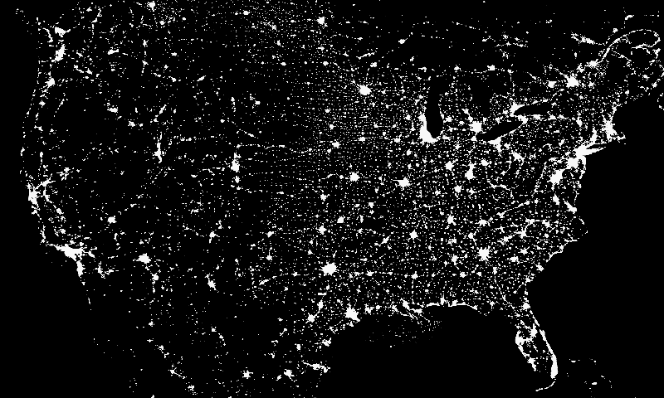
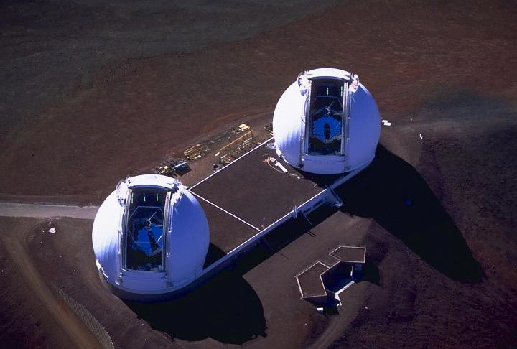
Most major observatories are located in remote, high
elevation locations in order to minimize light and
atmospheric interference

Slide 13
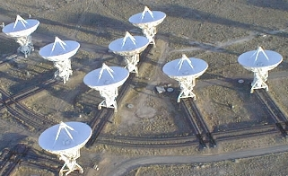
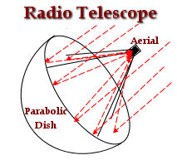
Radio Telescopes
Used to study radio waves (not visible light)
Use the same principle as radar
Can be very large
Satellite dishes are kind of like a radio telescope
Very Large Array in New Mexico

Slide 14
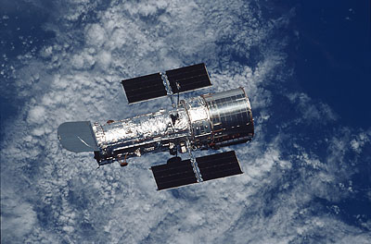
Hubble Space Telescope
Located outside of Earth’s atmosphere (about 350 miles or 589 Km above surface), so it can “see” more
Orbits Earth once every 97 minutes
Can detect UV, visible and infrared forms of EMR
Solar-powered
http://blogs.nature.com/news/thegreatbeyond/hubble.jpg

Slide 15
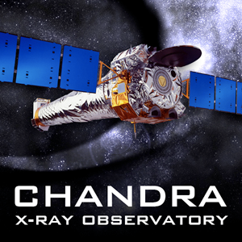
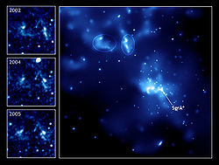
Chandra X-Ray Observatory
Unmanned satellite launched in 1999
Located outside of Earth’s atmosphere
Studies X-ray emissions from supernovas, black holes, neutron stars, etc.
Sagittarius A- supermassive black hole at center of Milky Way

Slide 16
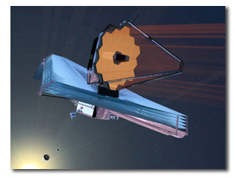
James Webb Telescope
Successor to Hubble
Will observe infrared light from faint and very distant objects
Will be much further away from Earth (about 1.5 million km) than Hubble
Launch during Oct 2018?

